Slide 1
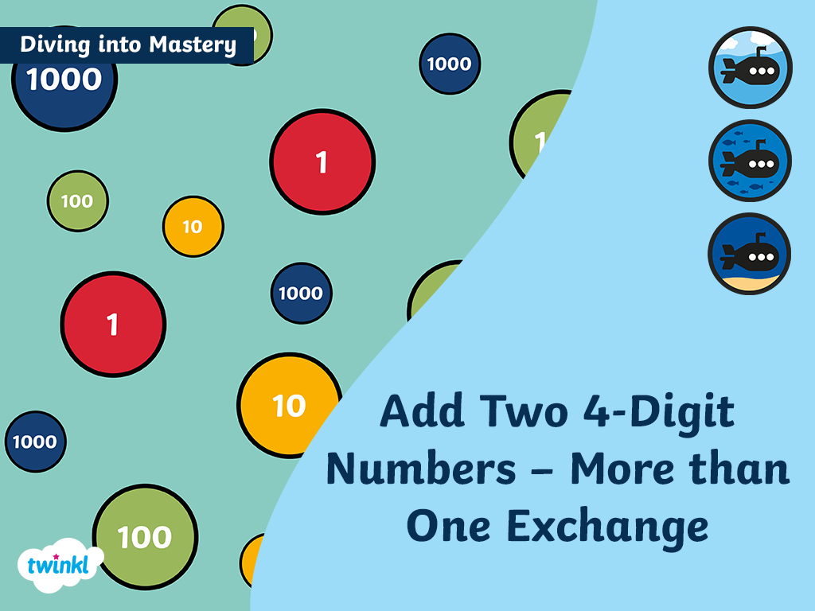

Slide 2



Diving into Mastery Guidance for Educators
Each activity sheet is split into three sections, diving, deeper and deepest, which are represented by the following icons:
These carefully designed activities take your children through a learning journey, initially ensuring they are fluent with the key concept being taught; then applying this to a range of reasoning and problem-solving activities.
These sheets might not necessarily be used in a linear way. Some children might begin at the ‘Deeper’ section and in fact, others may ‘dive straight in’ to the ‘Deepest’ section if they have already mastered the skill and are applying this to show their depth of understanding.
Diving
Deeper
Deepest

Slide 3
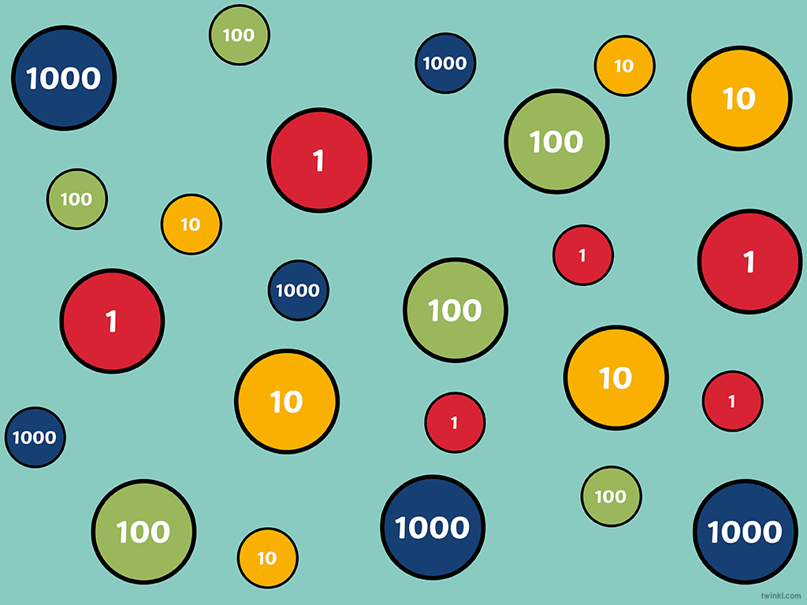
National Curriculum Aim
Add and subtract numbers with up to 4 digits using the formal written methods of columnar addition and subtraction where appropriate

Slide 4
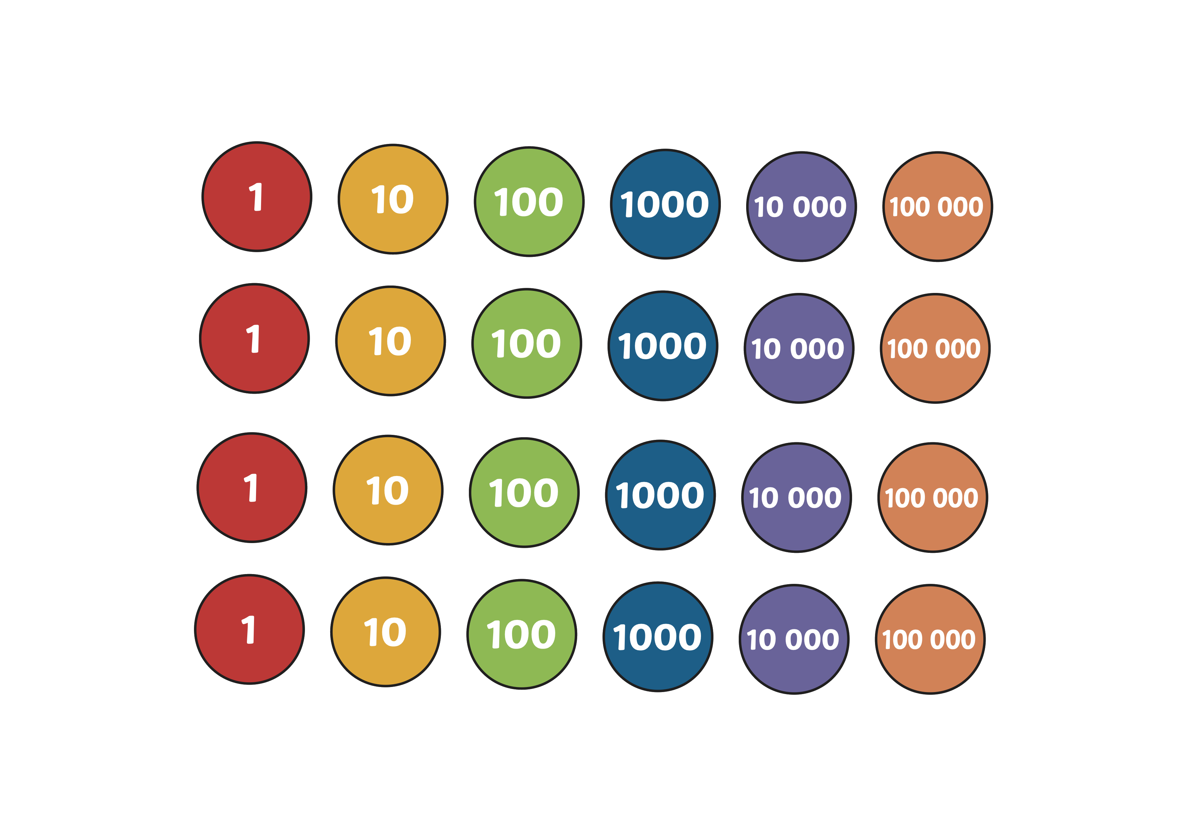
Add Two Four-Digit Numbers – More than One Exchange
Diving
Use the place value chart to complete the calculation.
3921
2657 + 1264 =
Th | H | T | O

Slide 5
Add Two Four-Digit Numbers – More than One Exchange
Diving
Use the place value chart to complete the calculation.
Th | H | T | O
 | Th | H | T | O
 | 3 | 4 | 4 | 8
+ | 3 | 1 | 6 | 4
6
6
1
2
1
1

Slide 6


Add Two Four-Digit Numbers – More than One Exchange
Deeper
Abi and Joseph are calculating 5868 + 1247.
Explain the mistakes the children have made.
Abi
 | Th | H | T | O
 | 5 | 8 | 6 | 8
+ | 1 | 2 | 4 | 7
 | 7 | 0 | 1 | 5
 | 1 | 1 | 1
Joseph
 | Th | H | T | O
 | 5 | 8 | 6 | 8
+ | 1 | 2 | 4 | 7
 | 7 | 1 | 0 | 5
 | 1 | 1
Abi has forgotten to add on the regrouped hundred.
Joseph has not regrouped 15 ones for 1 ten and 5 ones.

Slide 7
Add Two Four-Digit Numbers – More than One Exchange
Deeper
Is Emily’s statement true or false? Explain your answer.
Th | H | T | O
I only need to regroup two times to complete this calculation.
Emily
Emily’s statement is false because you will have to regroup three times to complete this calculation correctly.

Slide 8

Add Two Four-Digit Numbers – More than One Exchange
Deepest
How many different solutions can you find to complete this calculation?
 | Th | H | T | O
 | 6 | 3 |  | 4
+ | 3 | 4 |  | 9
 | 9 | 8 | 6 | 3
 |  | 1 | 1
The digits in the tens column needs to have a total of 15 tens.
The possible solutions are:
6394 + 3469
6364 + 3499
6384 + 3479
6374 + 3489

Slide 9
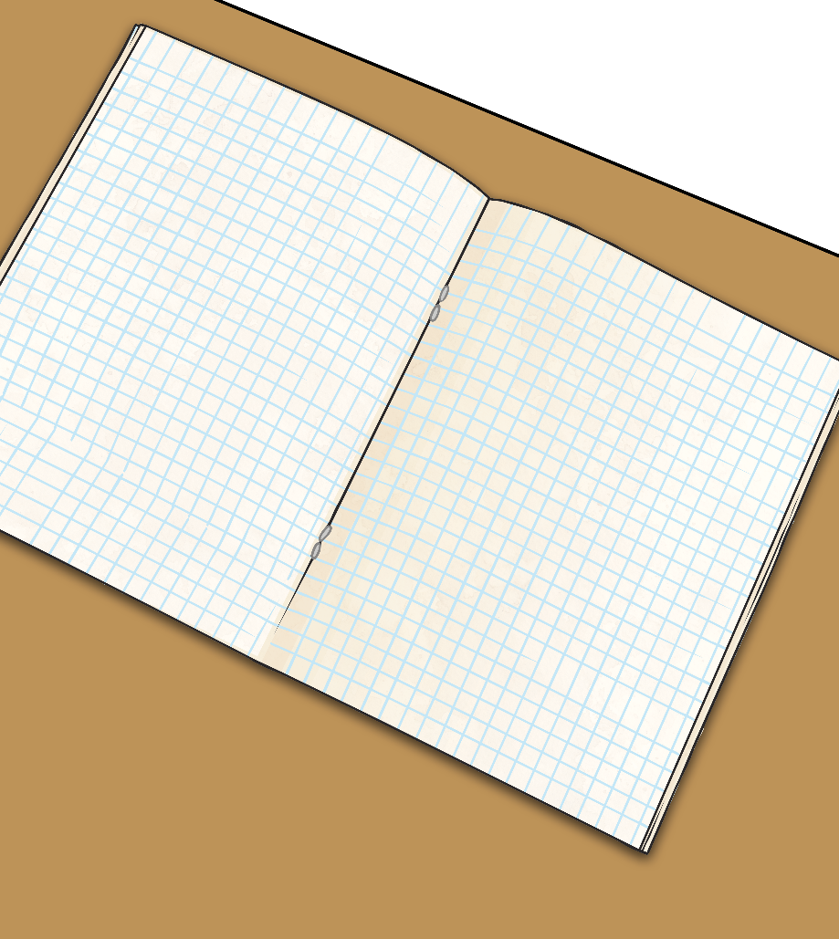
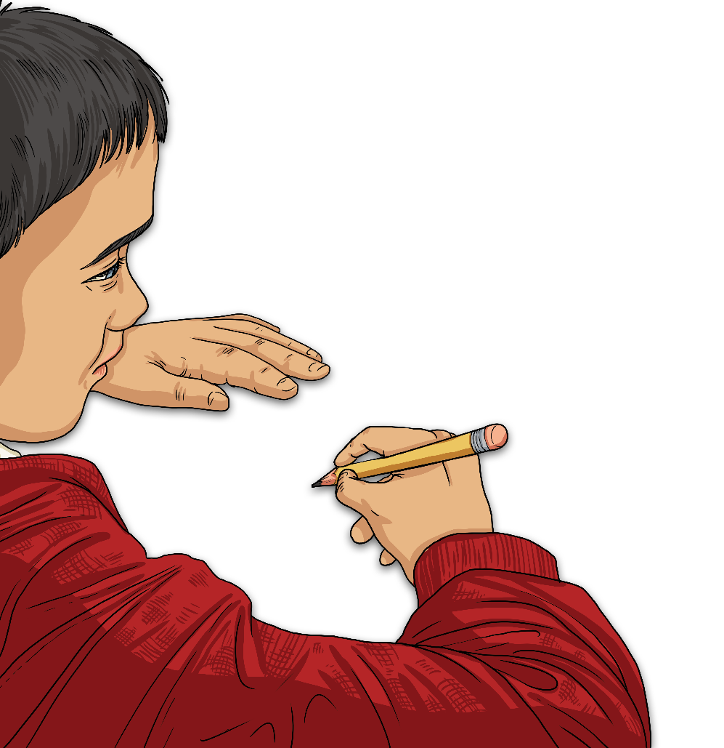
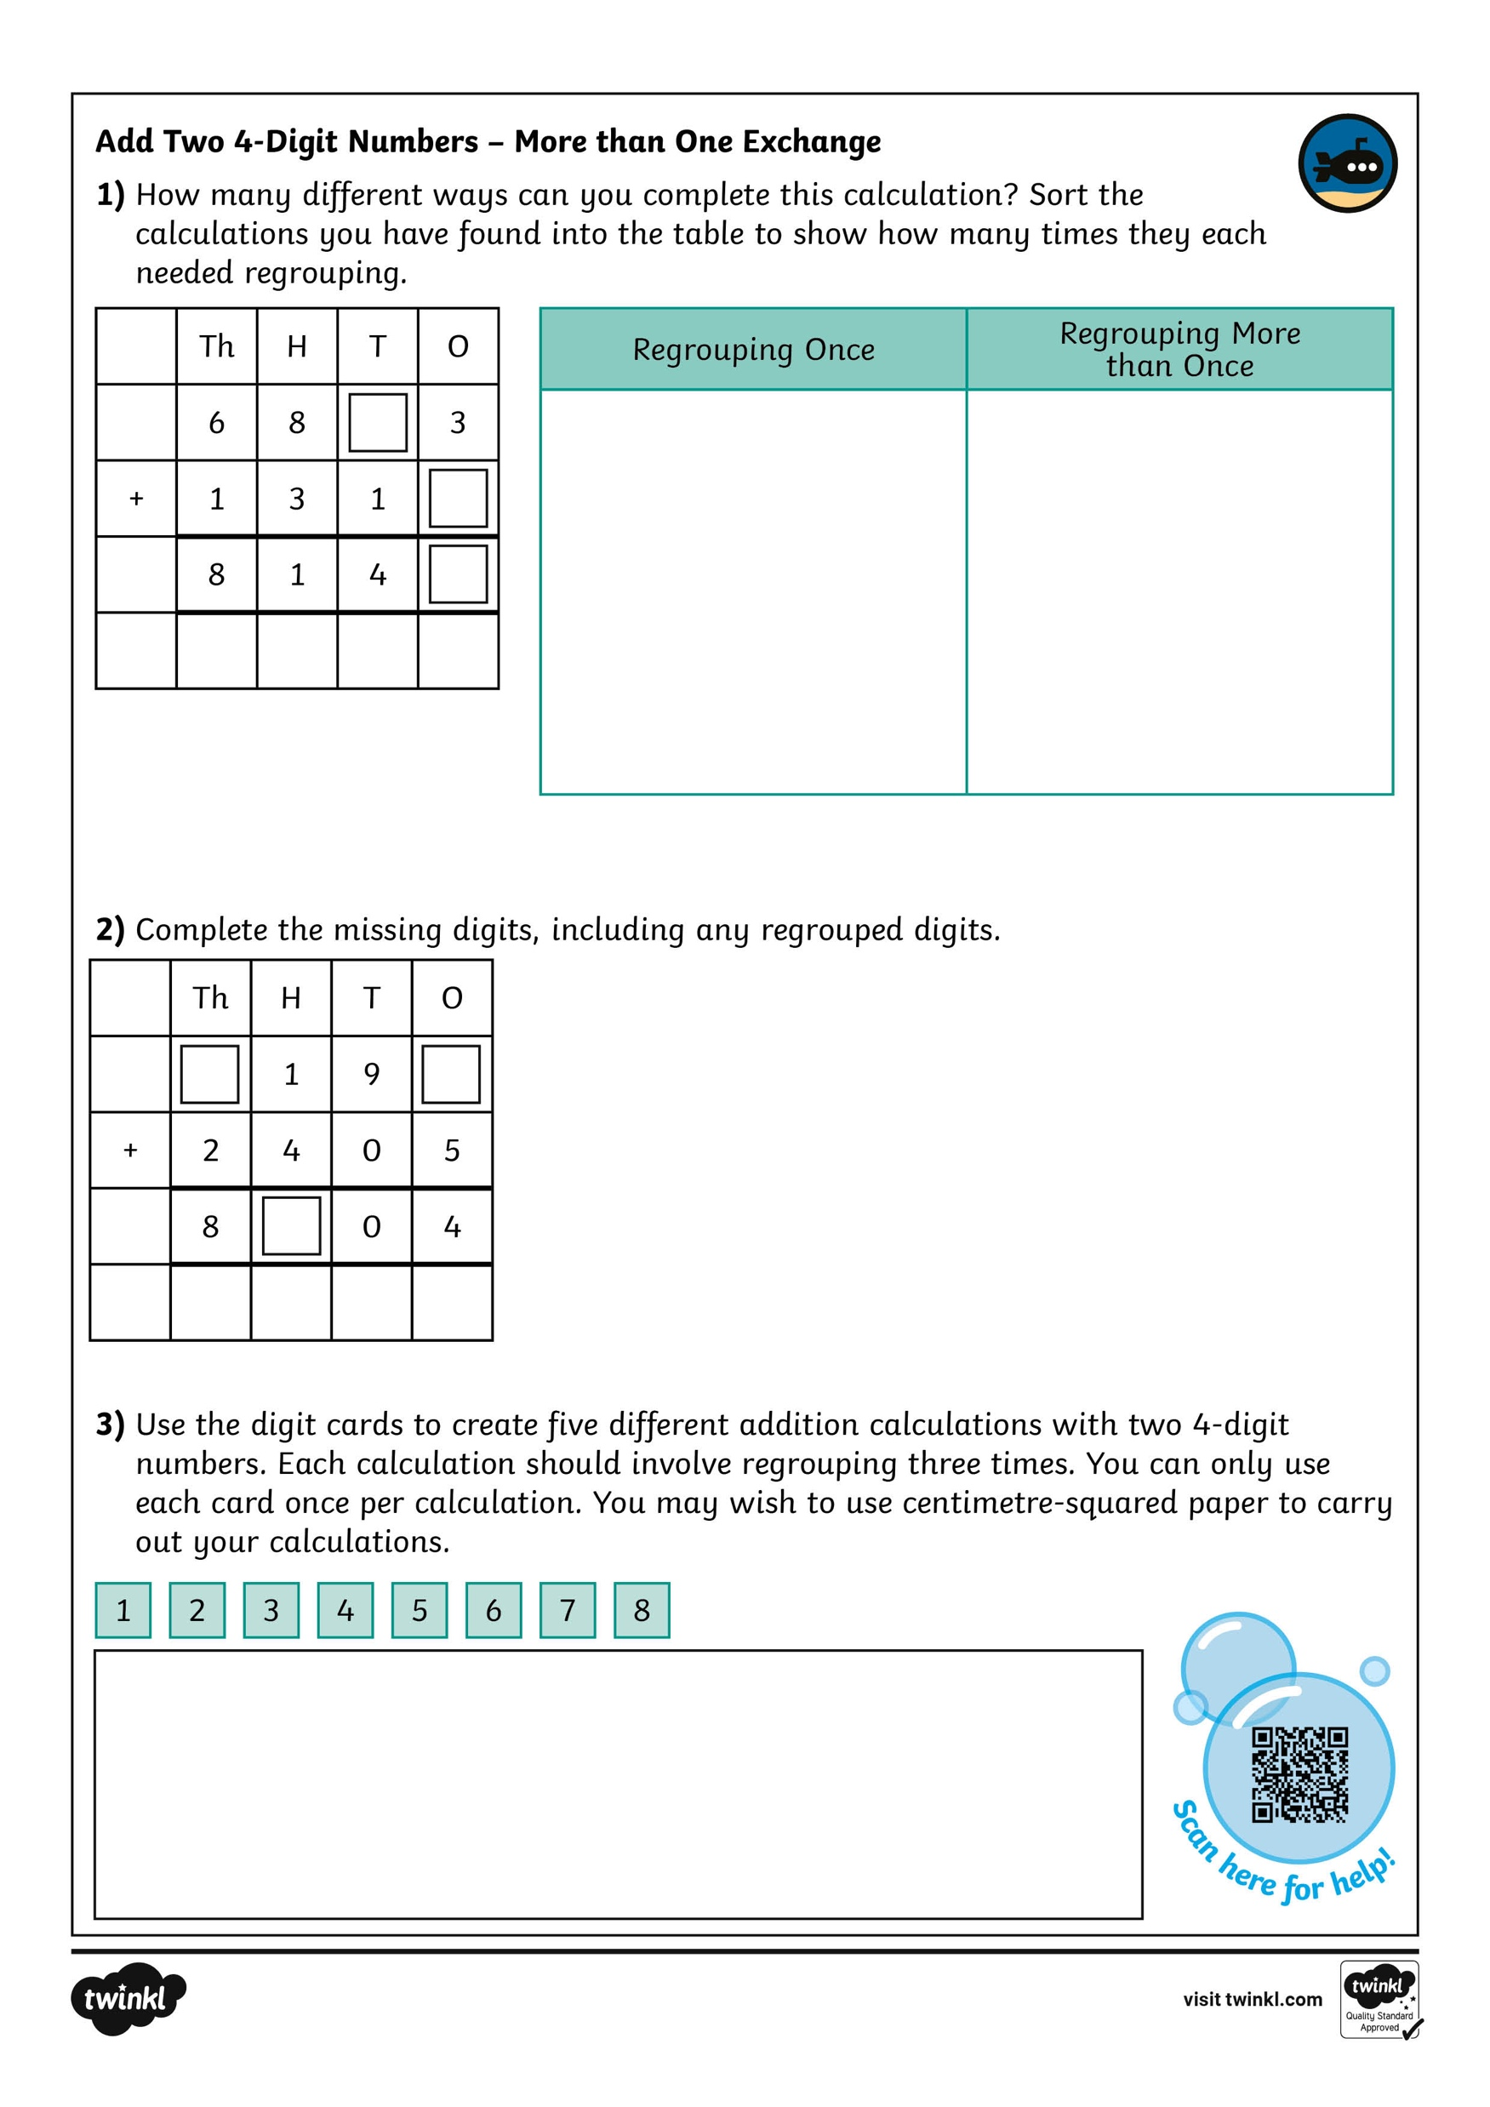
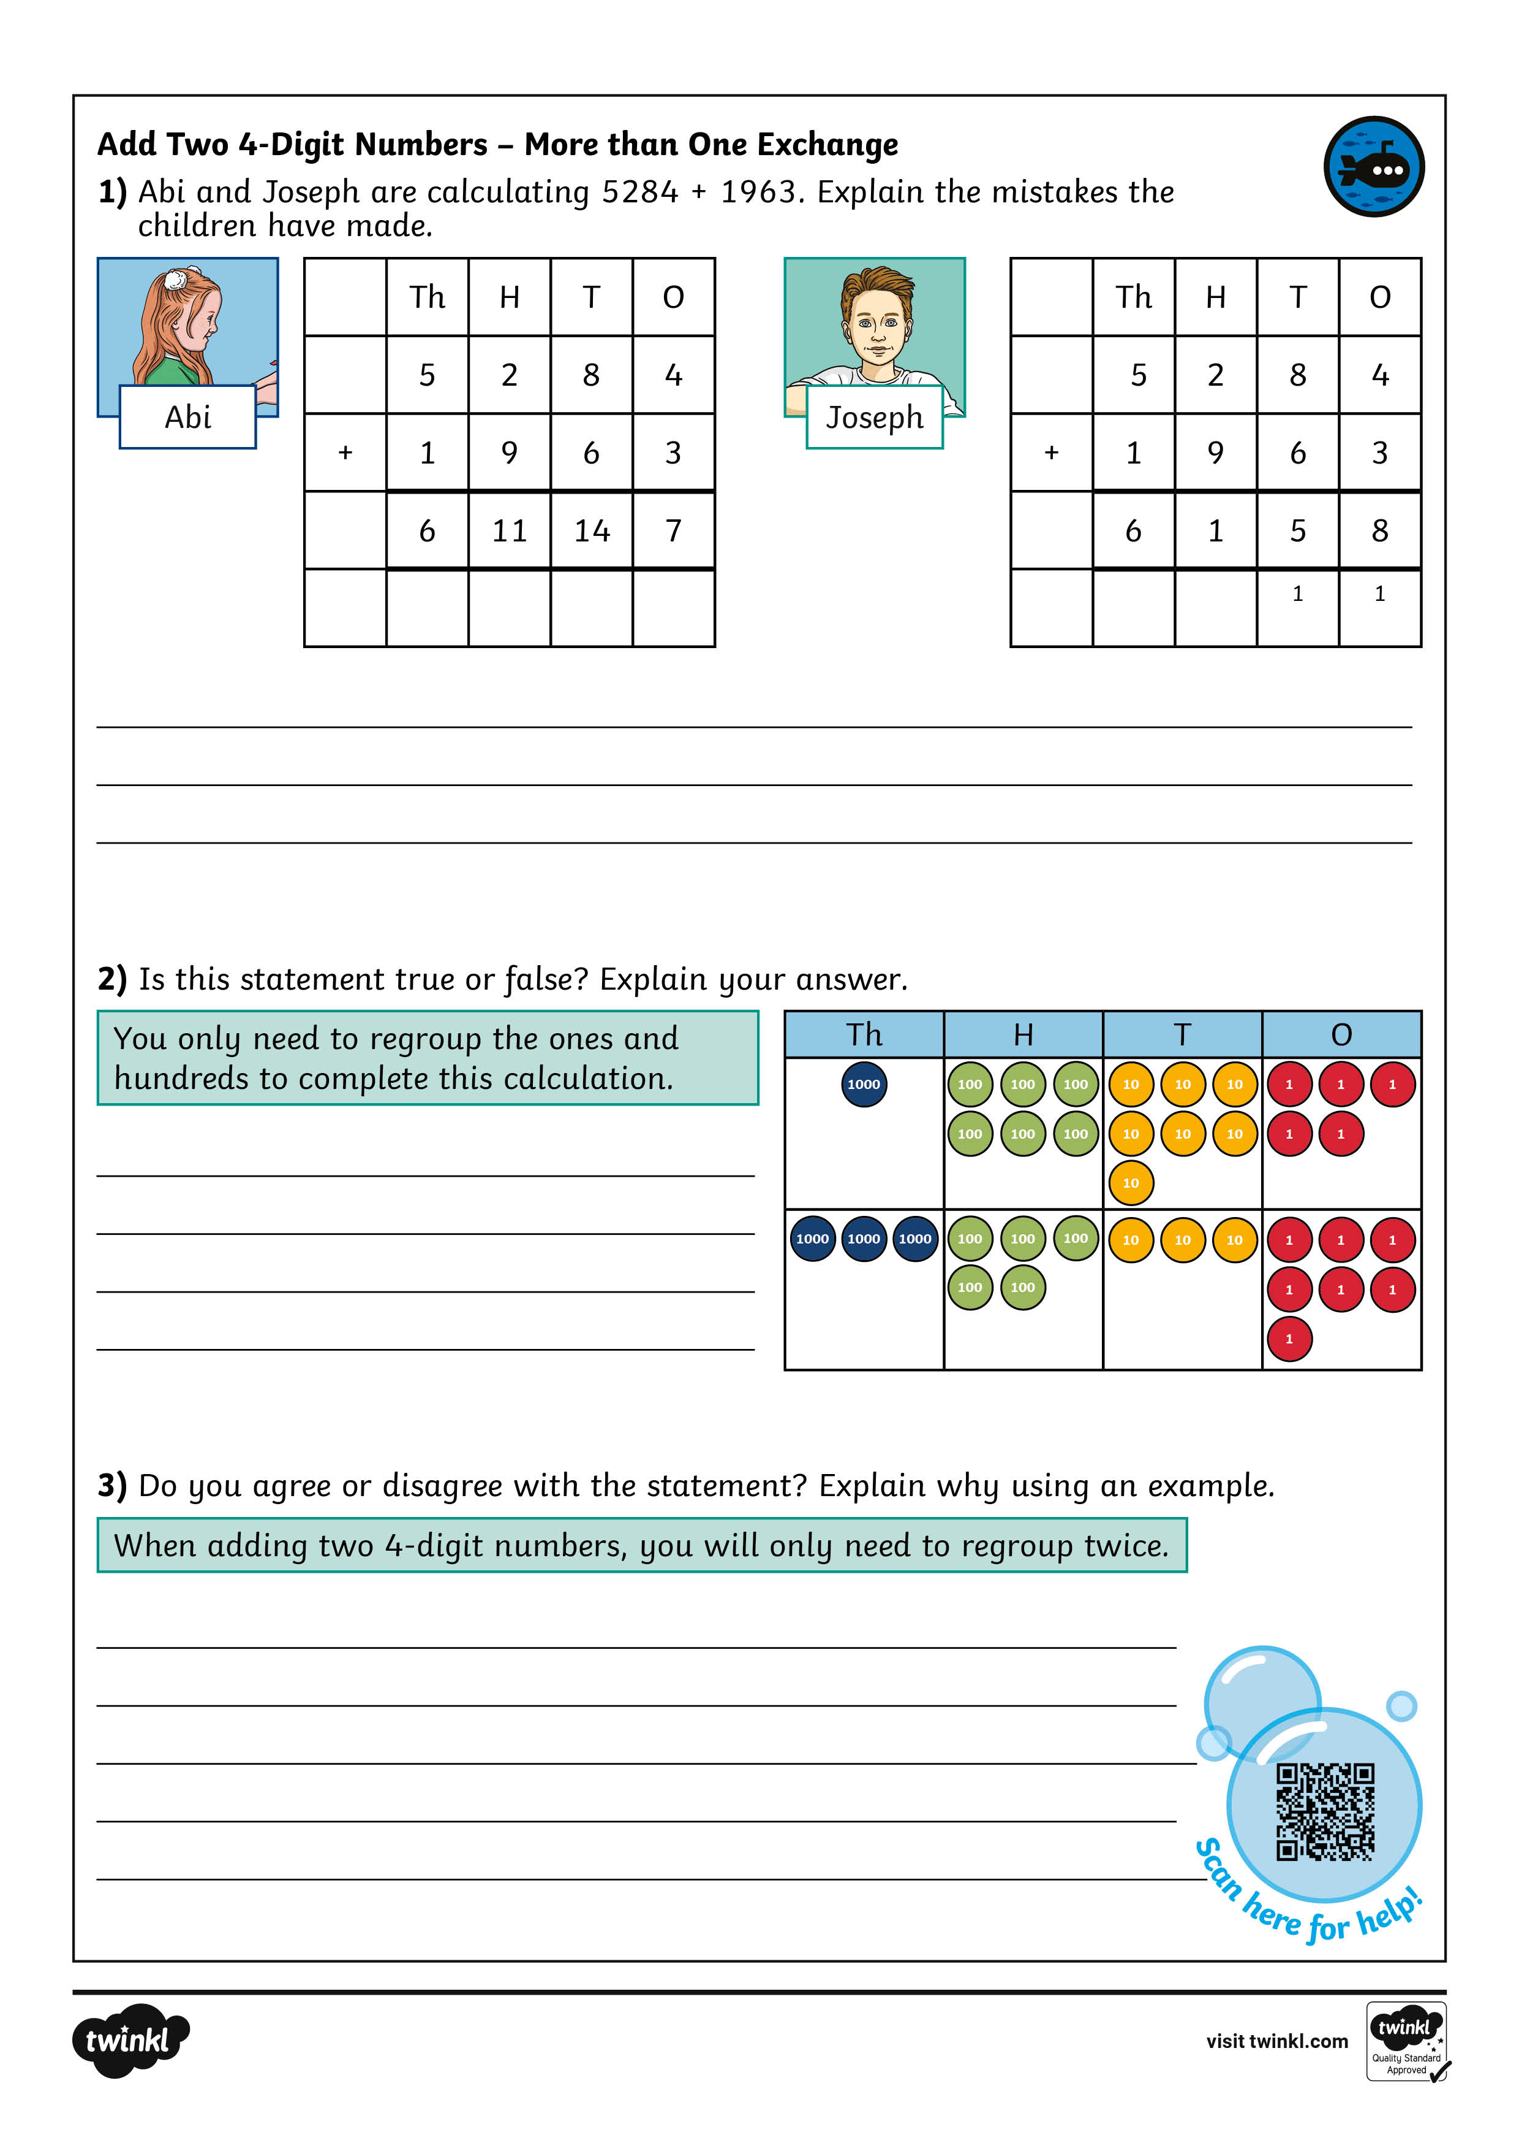
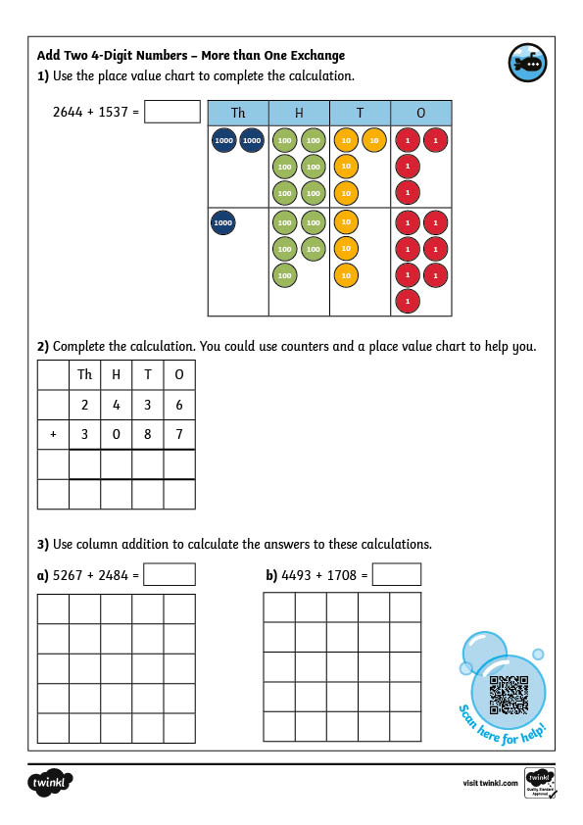
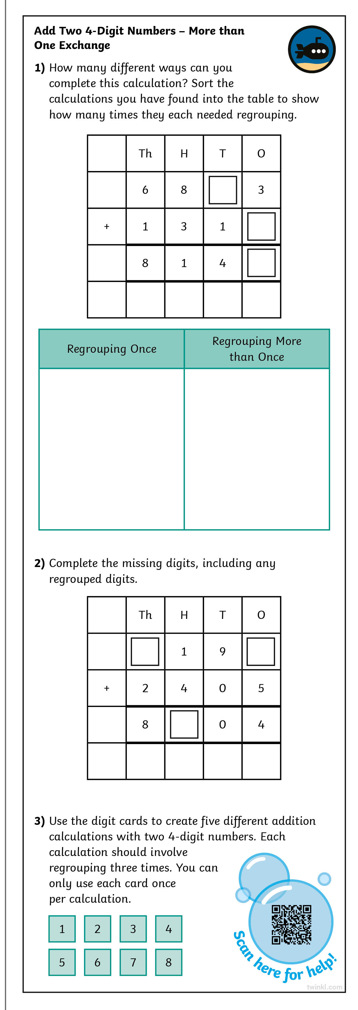
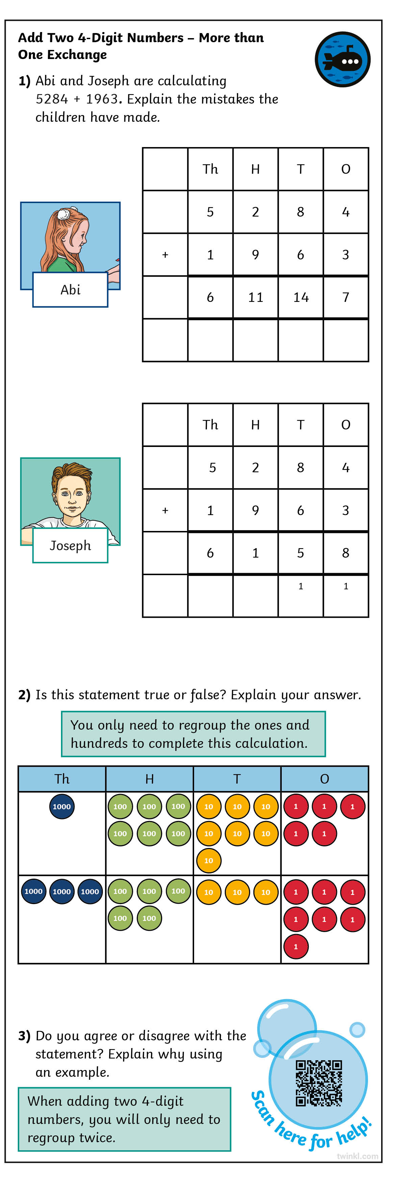
Add Two Four-Digit Numbers – More than One Exchange
Dive in by completing your own activity!

Slide 10



Need Planning to Complement this Resource?
National Curriculum Aim
Add and subtract numbers with up to 4 digits using the formal written methods of columnar addition and subtraction where appropriate
For more planning resources to support this aim, click here.
Twinkl PlanIt is our award-winning scheme of work
with over 4000 resources.

Slide 11
